Slide 1
Automation Help Request
January 2016

Slide 2
Three areas of help
Creating more stable “For Review” flags in high level workplans (Excel file)
Review flags must be added to Day 1 Project List tab for every region
Review flags must be added to Project Plan(s) tab for every region
Automating Global Dashboard (Excel file)
Data comes from High level work plan, Day 1 Project tab for every region
Automating Milestone Dashboards: (Excel File)
People Services- source data is Project Plan(s) tab for every region
Financial Services- source data is Project Plan(s) tab for every region
Credit- source data is Project Plan(s) tab for Hank Cochran file (US only)
Treasury- source data is Project Plan(s) tab for Europe (I. Katus, SAM T. Nossa)
Procurement Services- source data is Project Plan(s) tab for Europe (I. Katus) and US (Hank Cochran)

Slide 3
Review Flag methodology at project and task level (required in every region’s high level workplan file)
Review Flag | Description | Fields/ Calculation
NEW: Start Date | Flag triggered if Start Date is delayed greater than 5 days in comparison to the week prior | Start Date (NOTE: Calculated field based on Required Completion Date and Days to Accomplish)
NEW: Completion Date | Flag triggered if Required Completion date is delayed greater than 5 days in comparison to the week prior | Required Completion Date
NEW: % Complete progression | Flag triggered if the % complete is not aligned with days remaining to complete task | IF(%complete<(Required Completion Date-Days to Accomplish)/Days to Accomplish ))= Review
% Tasks for review (PROJECT LEVEL ONLY) | Flag triggered if greater than 25% of Tasks for a specific project are flagged for review based on flag criteria above | IF(Count of # of tasks “For GSS PMO Review”/ Total # of tasks in Project)>. 25
Off Track or at risk (PROJECT LEVEL ONLY) | Flagg triggered if project Status is “off-track” or “At Risk” | IF(STATUS=“Off Track” OR “At Risk”

Slide 4
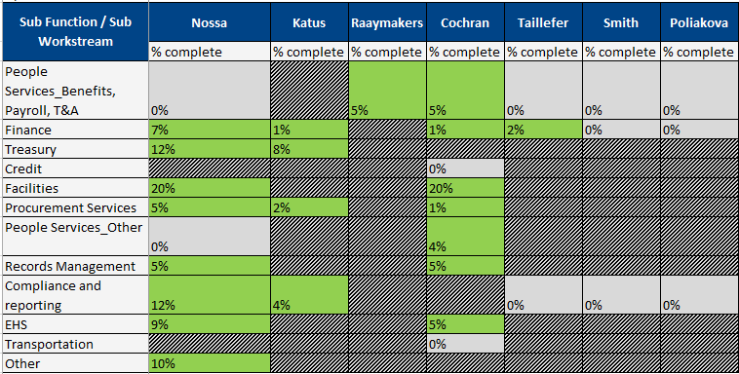
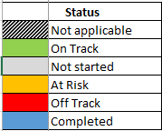
Global Dashboard (Excel document- data comes from Day 1 Project List tab for every region)
Provides project level status by sub-workstream
% Complete Source Data
Self reported at project level
Takes average % complete of all projects in scope
Status Source Data
Self reported at project level
If all projects in scope are on track or not started, sub-workstream remains at on track
If one project is At Risk or Off track, entire sub-workstream is updated accordingly

Slide 5
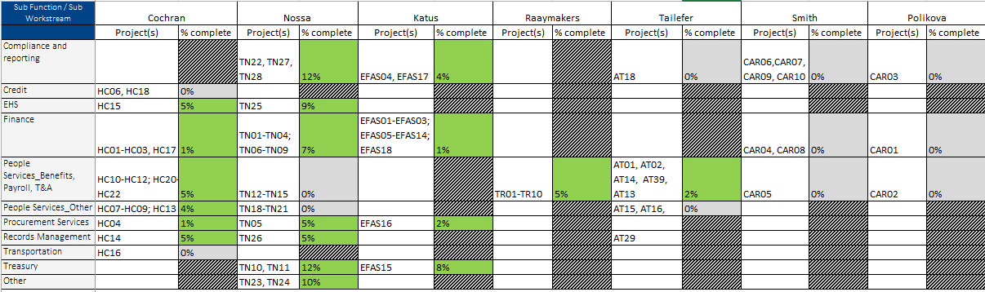
Global Dashboard- In-scope projects for tracking (Excel document- data comes from Day 1 Project List tab for every region)

Slide 6
Milestone Dashboards (Excel document- data comes from Project Plan(s) tab for every region)
Global collaboration to create common critical milestones for dashboard tracking
Milestone Dashboard | Scope Definition | In scope Project #’s for tracking
People Services | Payroll, T&A, Benefits Admin, Global Mobility | HC10-HC13, HC19-HC22; TN12-TN16; TR01-TR10, AT01, AT02, AT14, AT39, AT13, CAR05, CAR02
Financial Services | Finance System Support, General Ledger, FAPA, Cost Accounting, Accounts Payable, Accounts Receivable, T&E | HC01-HC03, HC17; TN01-TN04, TN06-TN09; EFAS01-EFAS03; EFAS05-EFAS14, EFAS18; CAR04, CAR08; CAR01
Credit | Global Credit | HC06, HC18
Treasury | Treasury | TN10, TN11; EFAS15
Procurement | Procurement Services Center | HC04, EFAS16

Slide 7
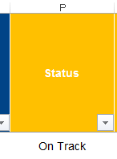
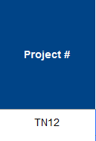
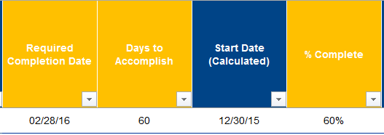
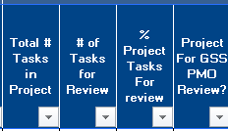
Key columns you will use to assist with automation (Day 1 Project List)
Fields you will use
Calculated Review flag Fields you will add
Start Date Review Flag
Completion Date Review Flag
% Complete Progression Review Flag
At Risk or Off Track Status review flag

Slide 8
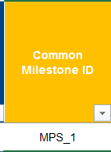
Key columns you will use to assist with automation (Day 1 Project Plans)
Calculated Review flag Fields you will add
Start Date Review Flag
Completion Date Review Flag
% Complete Progression Review Flag
At Risk or Off Track Status review flag

Slide 9
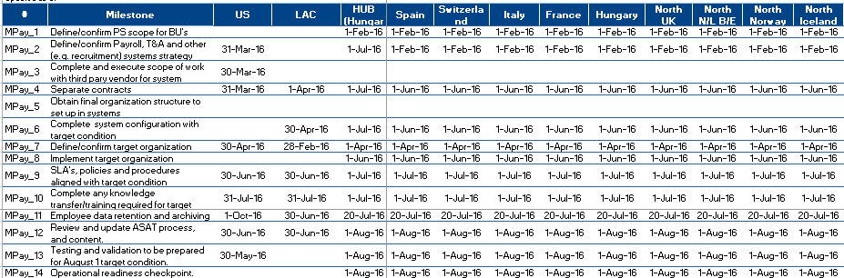
DRAFT: People Services Milestone Dashboard
Required Completion Date
Self reported at task level (common milestone to be identified by a specific field)
Status Source Data
Self reported at task level (common milestone to be identified by a specific field)

